Slide 1
Parse Table Composition Separate Compilation and Binary Extensibility of Grammar
PROJECT GUIDE: PROJECT MEMBERS:
DR..A.SAIRAM T.ROHIT[192224217]
M.Mohammad Hussain [192211654]
M.ROHITH[192225039]

Slide 2
AIM
The aim of this project is to implement a parsing table, a fundamental data structure in compiler design, to facilitate efficient parsing of input strings according to a given grammar

Slide 3
ABSTRACT
"This project aims to develop a parsing table generator, a vital tool in compiler construction, to automate the process of creating parsing tables for given grammars.
The generator will accept input in the form of a grammar defined using formal notations like BNF or EBNF. It will then systematically analyze the grammar, identify terminals and non-terminals, calculate First and Follow sets, and construct a parsing table based on these sets. The generator will employ algorithms to efficiently handle ambiguities and conflicts in the grammar.
Additionally, it will provide error-checking mechanisms to ensure the integrity of the generated parsing table. The output will be a comprehensive parsing table that serves as a roadmap for parsers, enabling them to parse input strings according to the specified grammar rules. Overall, the parsing table generator aims to streamline the process of compiler development by automating the creation of essential parsing data structures."

Slide 4
INTRODUCTION
A syntax analyzer or parser takes the input from a lexical analyzer in the form of token streams.the parser analyze the source code(token stream)against the production rule to detect any errors in the code.
There are two types of parsers:Top down and bottom up
The LL(1)parser is a top down parser that does not require any back-tracking.
It is also called a predictive or non recursive parser.

Slide 5
LITERATURE SURVEY
"Parsing Techniques: A Practical Guide" by Dick Grune and Ceriel J.H. Jacobs: This book offers a practical approach to parsing techniques, including detailed explanations of parsing tables and how they are constructed.
"Compilers: Principles, Techniques, and Tools" by Alfred V. Aho, Monica S. Lam, Ravi Sethi, and Jeffrey D. Ullman: The book discusses LL(1), LR(0), SLR(1), LR(1), LALR(1), and other parsing algorithms along with their associated parsing tables.
Online Resources and Tutorials: Various online resources and tutorials provide explanations and examples of parsing tables in compiler design.

Slide 6
SYSTEM REQUIREMENT
Operating System: The code can be developed on various operating systems like Windows, Linux, or macOS.
Compiler: You'll need a C compiler to compile and run your C code. Commonly used C compilers include:
GCC (GNU Compiler Collection)
Clang
Microsoft Visual C/C++ Compiler (for Windows)
Intel C Compiler
Memory: The memory requirements will depend on the complexity of your grammar and the size of the parsing table you generate. Generally, parsing tables for most grammars are not excessively large, so a standard amount of RAM should suffice.
Storage: You'll need enough disk space to store your source code files, any additional libraries or dependencies, as well as the generated executables.
Text Editor or IDE: You'll need a text editor or an integrated development environment (IDE) to write your C code. Some popular options include:
Visual Studio Code
Sublime Text
Atom
Vim or Emacs (for more advanced users)
Eclipse
Code::Blocks
Xcode (for macOS)

Slide 7
EXISTING SYSTEM
Parser Generator Tools: Such as Yacc, Bison, ANTLR, JavaCC, and others, which automate the generation of parsing tables and parser code from a formal grammar specification.
Programming Languages and Libraries: Developers may use general-purpose programming languages such as C, C++, Java, Python, etc.,
Online Resources and Communities: Websites, forums, and communities focused on compiler design, parsing techniques, and language processing provide valuable resources, tutorials, and discussions related to parsing tables and parsers.

Slide 8
PROPOSED SYSTEMS
Advanced Parser Generators: Future parser generator tools may incorporate advanced features such as:
Support for parsing Expression Grammars (PEGs) which offer more expressive power compared to traditional CFGs.
Integration of domain-specific optimizations to improve parsing speed and memory usage.
Automatic parallelization of parsing tasks to take advantage of multi-core architectures.
Incremental Parsing Techniques: Incremental parsing techniques enable parsers to efficiently update their parse trees in response to small changes in the input, rather than re-parsing the entire input from scratch. Future advancements in this area could lead to:
Improved performance for IDEs and real-time parsing applications.
Enhanced support for interactive programming environments where code is continuously modified.

Slide 9
IMPLEMENTATION
Define the Grammar: Start by formally defining the grammar of the language you want to parse. You can use a notation like Backus-Naur Form (BNF) or Extended Backus-Naur Form (EBNF) to specify the grammar rules.
Choose a Parsing Algorithm: Decide on the parsing algorithm you want to use based on the characteristics of your grammar and the efficiency requirements of your parser. Common parsing algorithms include LL(1), LR(0), SLR(1), LR(1), LALR(1), etc.
Construct First and Follow Sets: For LL(1) parsing, compute the First and Follow sets for each non-terminal in your grammar. First sets represent the terminals that can start a string derived from a non-terminal, while Follow sets represent the terminals that can appear immediately after a non-terminal in a derivation.
Build the Parsing Table: Use the First and Follow sets to construct the parsing table. The parsing table is typically a 2D table where rows correspond to non-terminals, and columns correspond to terminals and end-of-input markers. Each entry in the table indicates the production rule or action to take when parsing a particular non-terminal with a particular terminal.
Implement the Parser: Based on the parsing algorithm and the parsing table, write the parser code. The parser reads input tokens and uses the parsing table to decide which production rule to apply at each step. The parser may use a stack or recursive descent approach, depending on the parsing algorithm.
Error Handling: Implement error handling mechanisms in the parser to detect and report syntax errors gracefully. Errors may include unexpected tokens, missing tokens, or other violations of the grammar rules.
Testing and Debugging: Test the parser with a variety of input strings, including valid inputs and inputs with syntax errors. Debug any issues that arise during testing by tracing the parser's behavior and comparing it with the expected output based on the grammar.
Optimization: Optimize the parser for efficiency if necessary. This may involve optimizing the parsing algorithm, reducing table size, or implementing other performance enhancements.
Documentation and Usage Guidelines: Document the implementation details of the parsing table and parser, including the grammar, parsing algorithm, parsing table construction process, and usage instructions for the parser.
Maintenance and Further Development: Maintain the parser codebase, addressing any bugs or issues that arise. Consider further development to enhance the parser's capabilities, such as adding support for additional language features or optimizing performance.

Slide 10
RESULT
The result of implementing a parsing table is a robust and efficient parser that enables the analysis and understanding of input strings according to a specified grammar, facilitating the development of language processing systems and tools.
Therefore, methods for deploying languages as binary components are necessary
to leverage the promise of extensible compilers. We call this binary extensibility.
One of the challenges in realizing binary extensible compilers is binary extensibility of the
syntax of the base language.
Most extensible compilers use an LR parser, therefore this requires the introduction of LR parse table components.

Slide 11
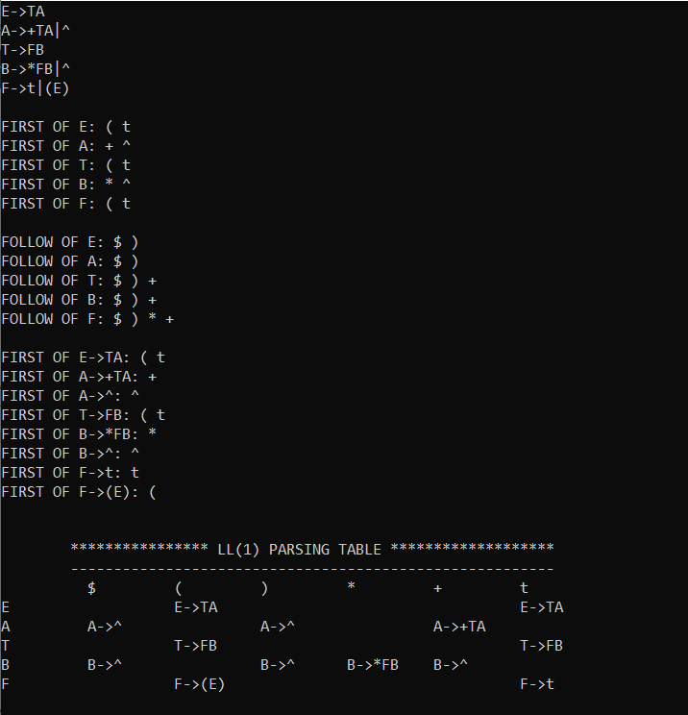
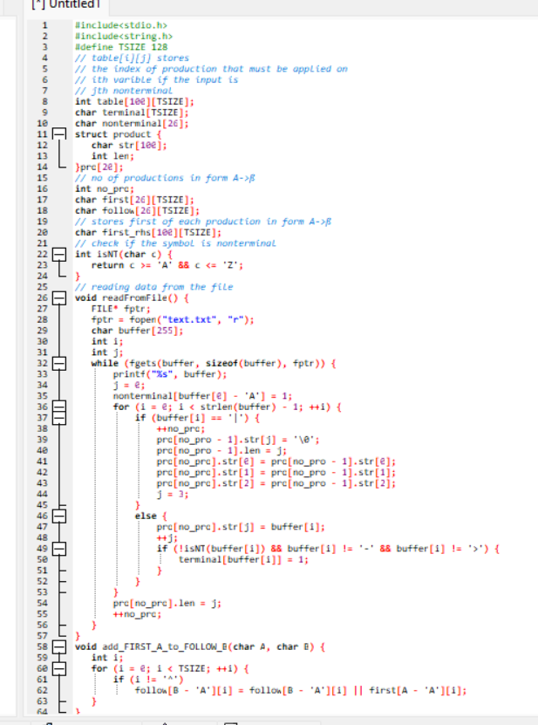
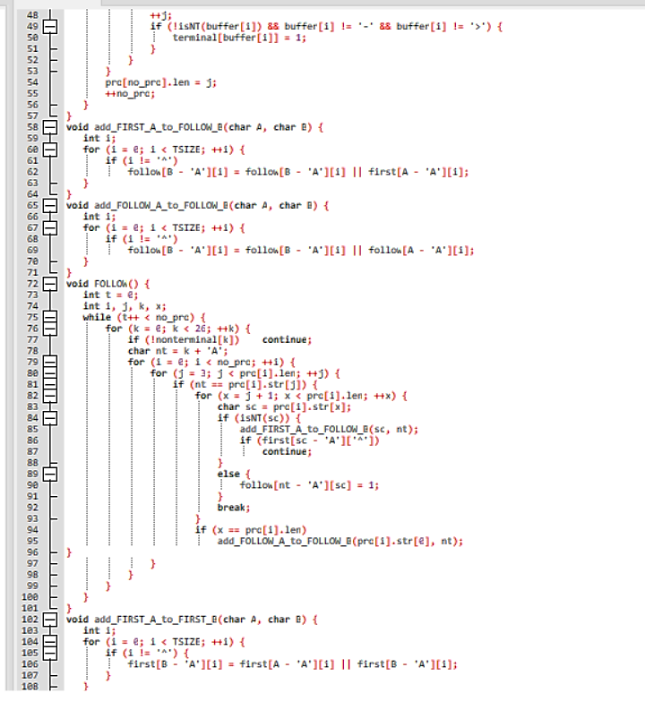
CODING & SCREEN SHOT

Slide 12
CONCLUSION
The successful implementation of a parsing table provides a foundational component for efficient parsing of input strings based on a specified grammar. By systematically analyzing the grammar, constructing appropriate data structures, and employing parsing algorithms, the project demonstrates the feasibility of automating the parsing process within compiler design. This enables developers to handle input strings according to defined grammar rules, thereby advancing the efficiency and accuracy of compiler development and contributing to the broader field of computational language processing.“
In conclusion, this project demonstrates the successful implementation of a parsing table for use in compiler design. It highlights the importance of parsing tables in parsing algorithms and discusses potential avenues for future research and improvement

Slide 13
REFERENCE
1. van Wyk, E., Krishnan, L., Schwerdfeger, A., Bodin, D.: Attribute grammar-based language
extensions for Java. In: ECOOP’07. LNCS, Springer (July 2007)
2. Ekman, T., Hedin, G.: The JastAdd extensible Java compiler. In: OOPSLA ’07, ACM Press
(2007) 1–18
3. Nystrom, N., Clarkson, M.R., Myers, A.C.: Polyglot: An extensible compiler framework for
Java. In: CC’03. Volume 2622 of LNCS., Springer (April 2003) 138–152
4. Bravenboer, M., Dolstra, E., Visser, E.: Preventing injection attacks with syntax embedding –
a host and guest language independent approach. [47]
5. Lhotak, O., Hendren, L.: Jedd: A BDD-based relational extension of Java. In: PLDI 2004,
ACM Press (2004)
6. Millstein, T.: Practical predicate dispatch. In: OOPSLA ’04, ACM (2004) 345–364
7. Arnoldus, B.J., Bijpost, J.W., van den Brand, M.G.J.: Repleo: A syntax-safe template engine.
[47]

